Slide 1
Best Neighborhoods in London Borough
Author: Jeetendra Swami

Slide 2
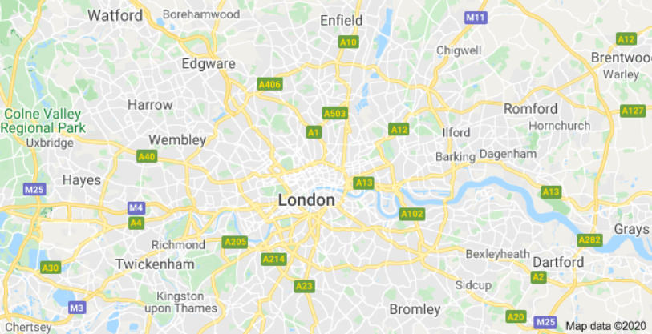
Where to live in London?
This study will develop a model to determine good neighborhoods in Delft to settle for young adults.

Slide 3
Data Collection:
Open source data has been used for this analysis:
FourSqaure API
Open data Delft

Slide 4
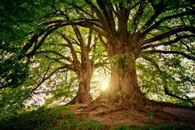
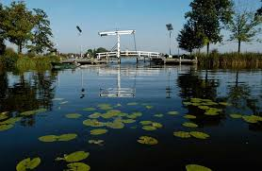
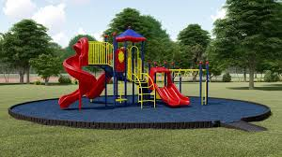
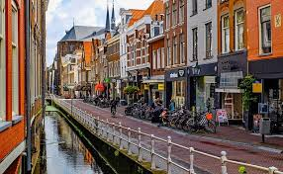
Model Features:
Features will be:
Tree population density per neighborhood
Water area density per neighborhood
Playground Tree population density per neighborhood
Venues -> clustered in three groups and weighted according to personal preference.
Trees in Delft
Water in Delft
Playground in Delft
Venues in Delft

Slide 5
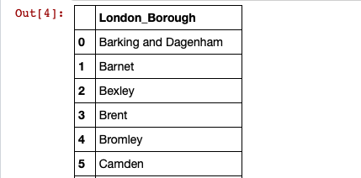
Data Cleaning
To find the London borough names, we use BeautifulSoup to scrape the wiki page. After that, string manipulation is done using regular expression and the exact name of the boroughs are extracted. Extracting the exact names is very important, as throughout the project, we will be using the Borough names as the index for the data frames.

Slide 6
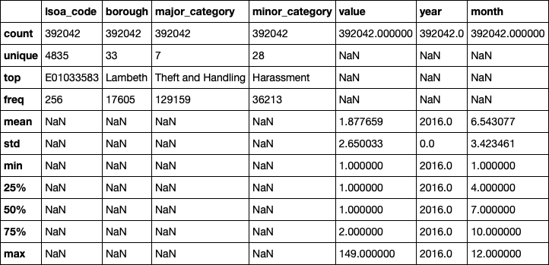
Exploratory Data Analysis
In this section, we will analyze the data frames built in the above section. And come up with the analysis on the best neighborhood in Sutton. It consists of the below steps:
Visualise the crime rates in the London boroughs to identify the safest borough and extract the neighborhoods in that borough to find the 15 most common venues in each neighborhood.
Visualise the price per m2 in each borough of London and extract the 15 values with the least values.
Analyse the happiness index and get the one with top 15 values

Slide 7
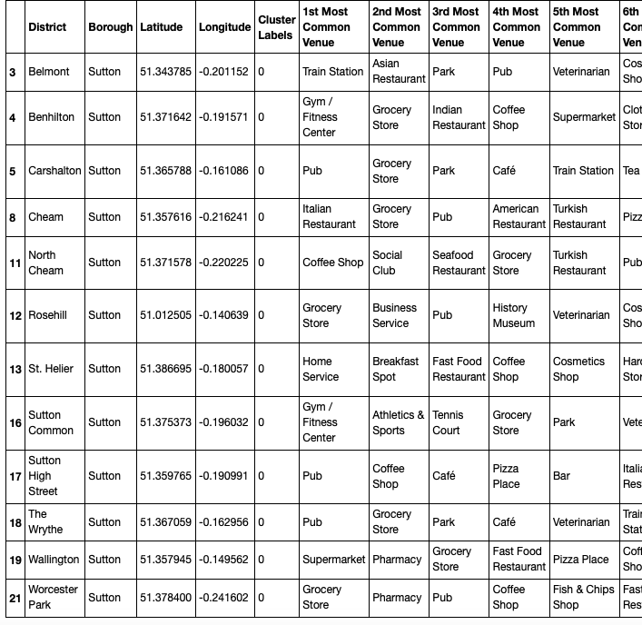
Final Result

Slide 8
Discussion & Conclusion
After clustering these neighborhoods into 6 clusters, we could see that the first cluster contains almost 12 neighborhood. If people prefer to live in a place where all the amenities like pubs, gym, pharmacy etc are at one hand distance, we could choose the first cluster. These are the areas which attracts a lot of floating crowd. Second cluster consist of only one area which has a museum, garden, pub etc. This could be where the tourists prefer(may be people who wanted to set up an AirBnB can check this area :p) Third cluster is a well connected cluster with train stations being the most common venues. People who travel to work can use this area. Fourth cluster is Beddington Corner which has a racetrack, business services and shops. It was not grouped with any other clusters due to the unique venue category. Fifth cluster consist of Bandon Hill with Gardens, hardware stores, pubs,museums etc. Sixth cluster consisting of Little Woodcote & Woodcote Green has lots of garden, parks, coffee shop, gym and grocery stores. This seems like an idyllic place with lots of green space. For a family, I think sixth cluster has the best neighborhoods.

